Slide 1

BELLABEAT
Smart Device Analysis
How Fitness Tracker Trends Can
Inform Bellabeat's Marketing Strategy
FitBit Dataset · 2016 · Junior Data Analyst

Slide 2
AGENDA
01
Business Task & Background
Today's
Presentation
02
Dataset Overview
03
Key Findings & Trends
04
Visualizations
05
Recommendations

Slide 3



01
Business Task
Objective
Key Questions
Stakeholders
Analyze smart device fitness data to discover how consumers use non-Bellabeat devices and uncover new growth opportunities.
What are smart device trends? How do they apply to Bellabeat customers? How can they shape marketing strategy?
Urška Sršen (CCO), Sando Mur (Co-founder), and the Bellabeat Marketing Analytics Team.
Bellabeat — a tech-driven wellness company for women founded in 2013 — seeks to leverage data insights to inform its global marketing strategy.

Slide 4






02 DATASET OVERVIEW
FitBit Fitness Tracker Data · CC0 Public Domain · Kaggle / Mobius
30
2016
18
Daily
FitBit Users
Data Year
CSV Files
Granularity
Data Includes:
Daily Steps & Distance
Calories Burned
Sleep Duration & Quality
Heart Rate Monitoring
Activity Intensity Levels
Sedentary Time Tracking
⚠ Limitation: Small sample (30 users), 2016 data — findings should be validated with more current, larger datasets.

Slide 5

03
Activity & Steps
~80%
Key Findings
Saturday = Peak Activity
Saturday consistently shows the highest average steps (~8,200) — users are most active on weekends.
of daily time
is sedentary
Daily Goal Gap
Most users fall below the recommended 10,000 steps/day. Average sits around 7,600 steps.
Steps by Day
Sedentary Dominance
Sedentary minutes make up the largest activity segment (~80%). Users sit for most of the day.
Calorie Peaks on Weekends
Sun
Mon
Tue
Wed
Thu
Fri
Sat
Saturday also peaks in calories burned — aligning with higher step counts and active minutes.

Slide 6
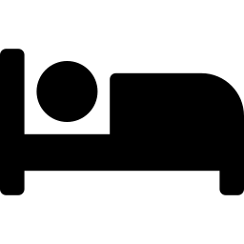
03
What the data tells us
Sleep Insights
Users average ~7 hours of sleep — slightly below the recommended 8 hours.
Sleep efficiency is consistently high (91%), suggesting good sleep quality overall.
419 min
Avg Sleep / Night (~7 hrs)
0.91
Wednesday shows the highest efficiency; Sunday the lowest — weekend disruption pattern.
Avg Sleep Efficiency
Wed
Wednesday also has the longest sleep duration (~450 min), possibly recovering from week stress.
Best Sleep Efficiency Day
Sun
Opportunity: Bellabeat can promote sleep improvement features and bedtime nudges.
Lowest Efficiency Day

Slide 7
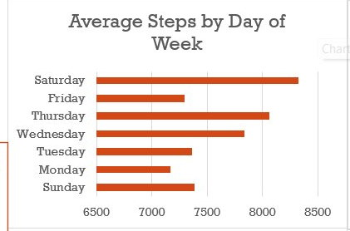
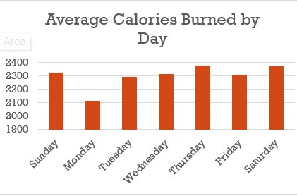
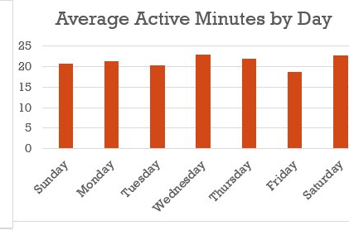
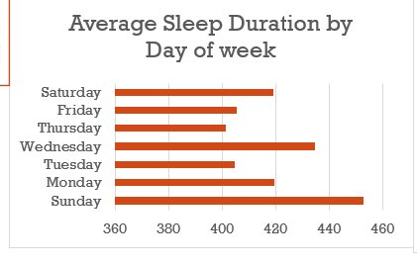
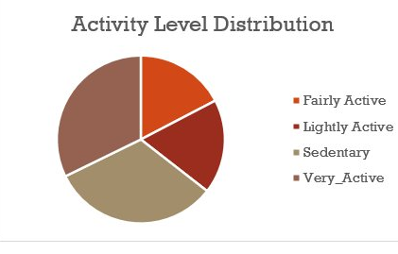
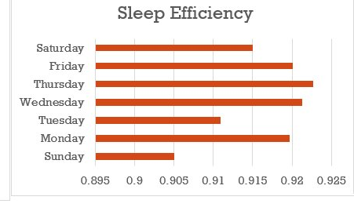
04 DASHBOARD · Key Charts
FitBit Fitness Tracker Data · 2016

Slide 8
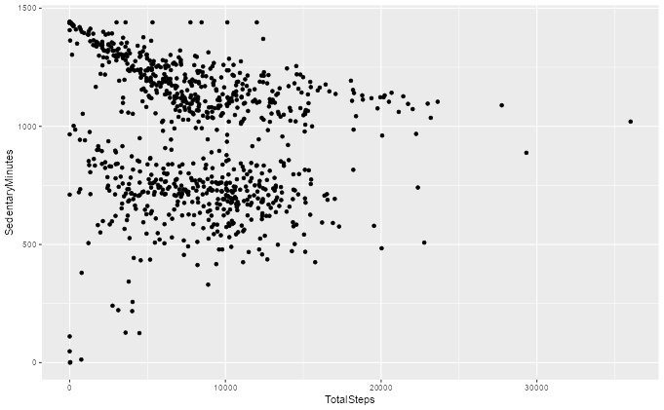
04 Steps vs Sedentary Time · Correlation Analysis
Negative Correlation
More steps taken → fewer sedentary minutes. Users who walk more sit less.
Cluster at Low Steps
Dense cluster near 0–5,000 steps with 1,000+ sedentary minutes — highly inactive segment.
Outliers Exist
Some users take 20,000–30,000 steps yet still show moderate sedentary time.
Marketing Opportunity
Target the large sedentary cluster with Bellabeat's activity nudge and coaching features.

Slide 9



05
Recommendations
Activity Nudge Notifications
1
Push smart reminders on low-activity days (Mon & Sun) to boost steps toward 10K. Position Bellabeat's Leaf as the always-on wellness companion.
Sleep Coaching Feature
2
Market personalized bedtime insights via the app. Sunday sleep inefficiency signals a key targeting moment for sleep-focused campaigns.
Weekend Warriors Campaign
3
Leverage Saturday peak activity in social campaigns. Showcase the Leaf and Time watch for active lifestyle users during peak weekends.
Hydration + Activity Tie-in
4
Promote the Spring bottle alongside activity data — users who walk more may benefit most from hydration reminders during workouts.

Slide 10
BELLABEAT
Empowering Women
Through Data-Driven Wellness
Thank you · Questions welcome
Data Source: FitBit Fitness Tracker Dataset (CC0) · Kaggle / Mobius · 2016

